Slide 1
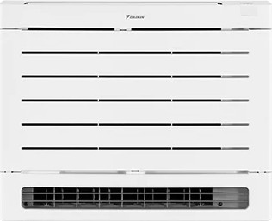

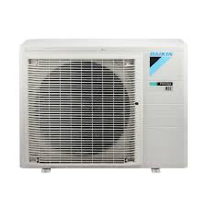
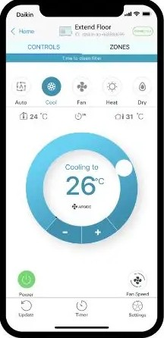
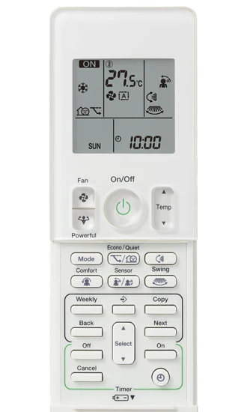

Aura Floor Standing
Cooling: 2.5 kW
Heating: 3.5 kW
Installation Included
Floor Warming
Dual Airflow
Built-in Wi-Fi

